Slide 1
PGM 2002/3 – Tirgul6
Approximate Inference:
Sampling

Slide 2
Approximation
Until now, we examined exact computation
In many applications, approximation are sufficient
  Example: P(X = x|e) = 0.3183098861838
  Maybe P(X = x|e) ≈ 0.3 is a good enough approximation
  e.g., we take action only if P(X = x|e) > 0.5
Can we find good approximation algorithms?

Slide 3
Types of Approximations
Absolute error
An estimate q of P(X = x | e) has absolute error ε, if
  P(X = x|e) - ε ≤ q ≤ P(X = x|e) + ε
equivalently
q - ε ≤ P(X = x|e) ≤ q + ε
Absolute error is not always what we want:
  If P(X = x | e) = 0.0001, then an absolute error of 0.001 is unacceptable
  If P(X = x | e) = 0.3, then an absolute error of 0.001 is overly precise
1
2ε
q
0

Slide 4
Types of Approximations
Relative error
An estimate q of P(X = x | e) has relative error ε, if
P(X = x|e)(1 - ε) ≤ q ≤ P(X = x|e)(1 + ε)
equivalently
q/(1 + ε) ≤ P(X = x|e) ≤ q/(1 - ε)
Sensitivity of approximation depends on
actual value of desired result
1
q/(1-ε)
q
q/(1+ε)
0

Slide 5
Complexity
Recall, exact inference is NP-hard
Is approximate inference any easier?
Construction for exact inference:
  Input: a 3-SAT problem Ψ
  Output: a BN such that P(X=t) > 0 iff Ψ is satisfiable

Slide 6
Complexity: Relative Error
Suppose that q is a relative error estimate of
P(X = t),
If Ψ is not satisfiable, then
P(X = t)(1 - ε) ≤ q ≤ P(X = t)(1 + ε)
0 = P(X = t)(1 - ε) ≤ q ≤ P(X = t)(1 + ε) = 0
Thus, if q > 0, then Ψ is satisfiable
An immediate consequence:
Thm:
Given ε, finding an ε-relative error approximation is NP-hard

Slide 7
Complexity: Absolute error
We can find absolute error approximations to
P(X = x)
  We will see such algorithms shortly
However, once we have evidence, the problem is harder
Thm
If ε < 0.5, then finding an estimate of P(X=x|e) with ε absulote error approximation is NP-Hard

Slide 8
Proof
Recall our construction
Q₁
Q₂
Q₃
Q₄
Q_{n}
...
Ψ₁
Ψ₂
Ψ₃
Ψ_{k-1}
Ψ_{k}
...
...
A₁
A₂
A_{k/2}
...
...
X

Slide 9
Proof (cont.)
Suppose we can estimate with ε absolute error
Let p₁ ≈ P(Q₁ = t | X = t)
  Assign q₁ = t if p₁ > 0.5, else q₁ = f
Let p₂ ≈ P(Q₂ = t | X = t, Q₁ = q₁ )
  Assign q₂ = t if p₂ > 0.5, else q₂ = f
…
Let p_{n} ≈ P(Q_{n} = t | X = t, Q₁ = q_{1, …,} Q_{n-1} = q_{n-1} )
  Assign q_{n} = t if p_{n} > 0.5, else q_{n} = f

Slide 10
Proof (cont.)
Claim: if Ψ is satisfiable, then q₁ ,…, q_{n} is a satisfying assignment
Suppose Ψ is satisfiable
By induction on i there is a satisfying assignment with Q₁ = q₁, …, Q_{i} = q_{i}
Base case:
If Q₁ = t in all satisfying assignments,
  ⇒ P(Q₁ = t | X = t) = 1
  ⇒ p₁ ≥ 1 - ε > 0.5
  ⇒ q₁ = t
If Q₁ = f, in all satisfying assignments, then q₁ = f
Otherwise, statement holds for any choice of q₁

Slide 11
Proof (cont.)
Claim: if Ψ is satisfiable, then q₁ ,…, q_{n} is a satisfying assignment
Suppose Ψ is satisfiable
By induction on i there is a satisfying assignment with Q₁ = q₁, …, Q_{i} = q_{i}
Induction argument:
If Q_{i+1} = t in all satisfying assignments s.t.Q₁ = q₁, …, Q_{i} = q_{i}
  ⇒ P(Q_{i+1} = t | X = t, Q₁ = q₁, …, Q_{i} = q_{i} ) = 1
  ⇒ p_{i+1} ≥ 1 - ε > 0.5
  ⇒ q_{i+1} = t
If Q_{i+1} = f in all satisfying assignments s.t.Q₁ = q₁, …, Q_{i} = q_{i}
then q_{i+1} = f

Slide 12
Proof (cont.)
We can efficiently check whether q₁ ,…, q_{n} is a satisfying assignment (linear time)
  If it is, then Ψ is satisfiable
  If it is not, then Ψ is not satisfiable
Suppose we have an approximation procedure with ε relative error
⇒ we can determine 3-SAT with n procedure calls
⇒ approximation is NP-hard

Slide 13
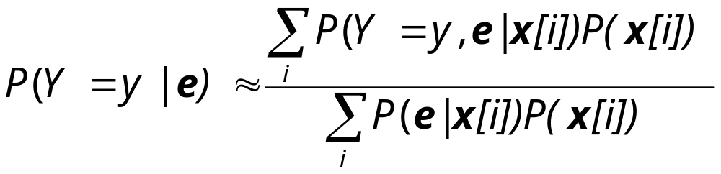
Search Algorithms
Idea: search for high probability instances
Suppose x[1], …, x[N] are instances with high mass
We can approximate:
If x[i] is a complete instantiation, then P(e|x[i]) is 0 or 1

Slide 14
Search Algorithms (cont)
Instances that do not satisfy e, do not play a role in approximation
We need to focus the search to find instances that do satisfy e
Clearly, in some cases this is hard (e.g., the construction from our NP-hardness result)

Slide 15
Stochastic Simulation
Suppose we can sample instances <x₁,…,x_{n}> according to P(X₁,…,X_{n})
What is the probability that a random sample <x₁,…,x_{n}> satisfies e?
  This is exactly P(e)
We can view each sample as tossing a biased coin with probability P(e) of “Heads”

Slide 16
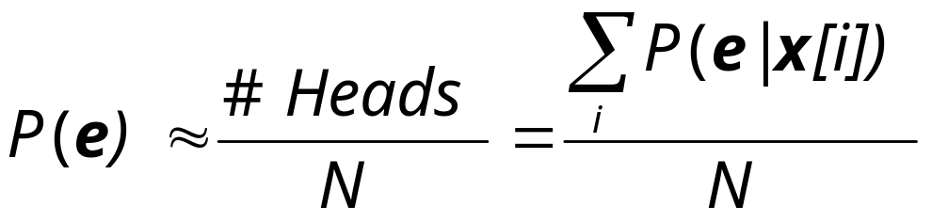
Stochastic Sampling
Intuition: given a sufficient number of samples x[1],…,x[N], we can estimate
Law of large number implies that as N grows, our estimate will converge to p with high probability
How many samples do we need to get a reliable estimation?
  Use Chernof’s bound for binomial distributions

Slide 17
Sampling a Bayesian Network
If P(X₁,…,X_{n}) is represented by a Bayesian network, can we efficiently sample from it?
Idea: sample according to structure of the network
  Write distribution using the chain rule, and then sample each variable given its parents

Slide 18
Logic sampling
P(b)
0.03
Earthquake
Burglary
0.03
P(e)
0.001
b e
b e
b e
b e
Radio
Alarm
P(a)
0.98
0.7
0.4
0.01
e
e
P(r)
0.3
0.001
Call
a
a
B E A C R
P(c)
0.8
0.05
b
Samples:

Slide 19
Logic sampling
P(b)
0.03
P(e)
0.001
Earthquake
Burglary
0.001
b e
b e
b e
b e
Radio
Alarm
P(a)
0.98
0.7
0.4
0.01
e
e
P(r)
0.3
0.001
Call
a
a
B E A C R
P(c)
0.8
0.05
b
e
Samples:

Slide 20
Logic sampling
P(b)
0.03
P(e)
Earthquake
Burglary
0.001
b e
b e
b e
b e
Radio
Alarm
P(a)
0.4
0.98
0.7
0.4
0.01
e
e
P(r)
0.3
0.001
Call
a
a
B E A C R
P(c)
0.8
0.05
b
e
a
Samples:

Slide 21
Logic sampling
P(b)
0.03
P(e)
Earthquake
Burglary
0.001
b e
b e
b e
b e
Radio
Alarm
P(a)
0.98
0.7
0.4
0.01
e
e
P(r)
0.3
0.001
Call
a
a
B E A C R
P(c)
0.8
0.05
0.8
b
e
a
c
Samples:

Slide 22
Logic sampling
P(b)
0.03
P(e)
Earthquake
Burglary
0.001
b e
b e
b e
b e
Radio
Alarm
P(a)
0.98
0.7
0.4
0.01
e
e
P(r)
0.3
0.3
0.001
Call
a
a
B E A C R
P(c)
0.8
0.05
b
e
a
c
r
Samples:

Slide 23
Logic Sampling
Let X₁, …, X_{n} be order of variables consistent with arc direction
for i = 1, …, n do
  sample x_{i} from P(X_{i} | pa_{i} )
  (Note: since Pa_{i} ⊆ {X₁,…,X_{i-1}}, we already assigned values to them)
return x₁, …,x_{n}

Slide 24
Logic Sampling
Sampling a complete instance is linear in number of variables
  Regardless of structure of the network
However, if P(e) is small, we need many samples to get a decent estimate

Slide 25
Can we sample from P(X₁,…,X_{n} |e)?
If evidence is in roots of network, easily
If evidence is in leaves of network, we have a problem
  Our sampling method proceeds according to order of nodes in graph
Note, we can use arc-reversal to make evidence nodes root.
  In some networks, however, this will create exponentially large tables...

Slide 26
Likelihood Weighting
Can we ensure that all of our sample satisfy e?
One simple solution:
  When we need to sample a variable that is assigned value by e, use the specified value
For example: we know Y = 1
  Sample X from P(X)
  Then take Y = 1
Is this a sample from P(X,Y |Y = 1) ?
X
Y

Slide 27
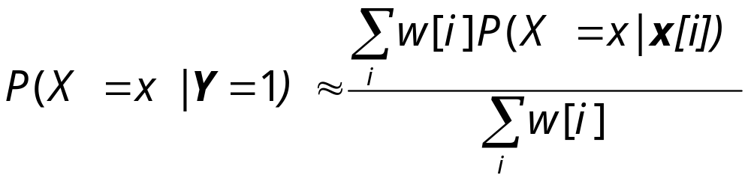
Likelihood Weighting
Problem: these samples of X are from P(X)
Solution:
  Penalize samples in which P(Y=1|X) is small
We now sample as follows:
  Let x[i] be a sample from P(X)
  Let w[i] be P(Y = 1|X = x [i])
X
Y

Slide 28
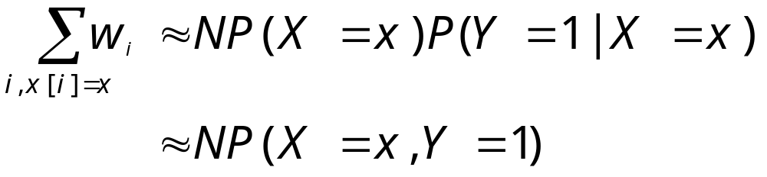
Likelihood Weighting
Why does this make sense?
When N is large, we expect to sample NP(X = x) samples with x[i] = x
Thus,
When we normalize, we get approximation of the conditional probability

Slide 29
Likelihood Weighting
P(b)
0.03
Earthquake
Burglary
0.03
P(e)
0.001
b e
b e
b e
b e
Radio
Alarm
P(a)
0.98
0.7
0.4
0.01
e
e
= r
= a
P(r)
0.3
0.001
Call
a
a
B E A C R
Weight
P(c)
0.8
0.05
b
Samples:

Slide 30
Likelihood Weighting
P(b)
0.03
P(e)
0.001
Earthquake
Burglary
0.001
b e
b e
b e
b e
Radio
Alarm
P(a)
0.98
0.7
0.4
0.01
e
e
= r
= a
P(r)
0.3
0.001
Call
a
a
B E A C R
Weight
P(c)
0.8
0.05
b
e
Samples:

Slide 31
Likelihood Weighting
P(b)
0.03
P(e)
Earthquake
Burglary
0.001
b e
b e
b e
b e
Radio
Alarm
P(a)
0.4
0.98
0.7
0.4
0.01
e
e
= r
= a
P(r)
0.3
0.001
Call
a
a
B E A C R
Weight
P(c)
0.8
0.05
b
e
a
0.6
Samples:

Slide 32
Likelihood Weighting
P(b)
0.03
P(e)
Earthquake
Burglary
0.001
b e
b e
b e
b e
Radio
Alarm
P(a)
0.98
0.7
0.4
0.01
e
e
= r
= a
P(r)
0.3
0.001
Call
a
a
B E A C R
Weight
P(c)
0.05
0.8
0.05
b
e
a
c
0.6
Samples:

Slide 33
Likelihood Weighting
P(b)
0.03
P(e)
Earthquake
Burglary
0.001
b e
b e
b e
b e
Radio
Alarm
P(a)
0.98
0.7
0.4
0.01
e
e
= r
= a
P(r)
0.3
0.3
0.001
Call
a
a
B E A C R
Weight
P(c)
0.8
0.05
b
e
a
c
r
0.6
*0.3
Samples:

Slide 34
Likelihood Weighting
Let X₁, …, X_{n} be order of variables consistent with arc direction
w = 1
for i = 1, …, n do
  if X_{i} = x_{i} has been observed
    w ←w* P(X_{i} = x_{i} | pa_{i} )
  else
    sample x_{i} from P(X_{i} | pa_{i} )
return x₁, …,x_{n,} and w

Slide 35
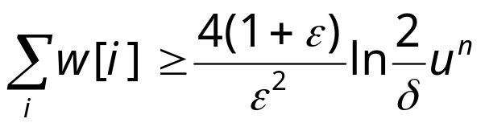
Likelihood Weighting
What can we say about the quality of answer?
Intuitively, the weights of sample reflect their probability given the evidence. We need collect a certain mass.
Another factor is the “extremeness” of CPDs.
Thm:
If P(X^{i} | Pa^{i}) ∈[l,u] for all CPDs, and
then with probability 1-δ, the estimate is ε relative error approximation

Slide 36
Importance Sampling
… will be here soon

